Slide 1
SSW Design Guide: Application Portal
Application publishing in the Sogeti Smart Workspace

Slide 2
SSW Design Guide: Application Portal
Application publishing in the Sogeti Smart Workspace
v1.1

Slide 3
The Application Portal Service Module
The main purpose of the service is to offer a central landing zone from which users can find and launch all the Business Applications they require in their day-to-day job.
The Application Portal can be purchased by Customers as a separate service or as a module, part of a Sogeti Smart Workspace offer. The service or module is implemented, managed and maintained by the Sogeti Service organization.
As an add-on, the Application Portal service can be extended with our packaging service. This consists of the service that already is delivered to our customers by the Sogeti Packaging Factory for a long time.

Slide 4
The Application Portal Service Module
The portal is web based and can be launched from any device, equiped with an HTML5 capable browser. Additionally, a local agent and/or browser extension may be added to provide additional functionality.
The portal uses its ‘own’ URL. For the standalone service, this URL is used by the end-users. For the SSW-full service, the application portal can be integrated in the SSW (SharePoint-) portal. In this case, the portal URL is only used directly as an alternative when SharePoint or the SSW-portal is not available.

Slide 5
What the application portal offers for users
Single entry point for users to find and launch all (corporate) applications
Applications that are installed on the device;
Web and SaaS applications;
Applications hosted in a remote workspace;
Users do not need to search for their applications as in traditional workspaces where these might be launched from the Start Menu, Browser favorites or Remote Desktop portal.
What’s behind the shortcut can be changed without user impact
Users still find their app in the same location

Slide 6
What the application portal offers for users
The application portal responds based on the user’s context
Apps enabled or use different launch path’s based on device type
Launch flow based on availability and/or versions present on the device
Application version
Local versus online (for example, Office apps)
Different apps with similar functionality
Preferred browser choice when applications work better in specific browser(s)
Apps enabled or use different launch path based on location (for example local when in the office, remote when outside corporate boundaries)

Slide 7
What the application portal offers for admins
Single pane of glass to publish managed applications
Single management portal to publish applications of all kinds
No deployment of new or updated applications required¹
Connectors for other platforms (like WVD, RDS or Citrix)²
Configure Single Sign On (SSO) with various IDPs (AAD/AD)
Dashboard for application use and error/issue logging (in preview)
This concerns the publication of the application only. The target still must be deployed separately off course.
Implementation depends on the product used for the Application Portal

Slide 8
Application Portal hosting
Delivered and managed as a service by Sogeti
Can be hosted on different locations*
Private zone in Shared Environment, hosted by Sogeti (< 500 users)
Dedicated setup in Shared Environment, hosted by Sogeti (preferred option)
Dedicated setup in Dedicated Environment, managed by Sogeti
User based, monthly subscription
Organisation tenant (called zone), can include one or more company domains
Supports single and multi-tenant setups

Slide 9
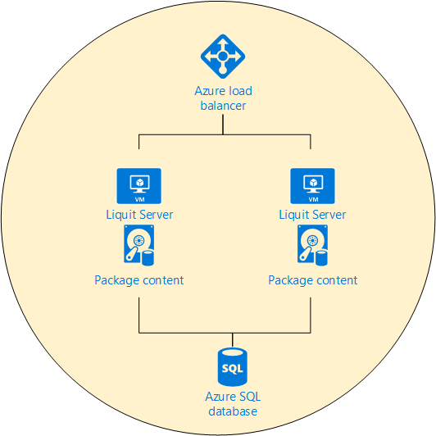

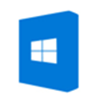


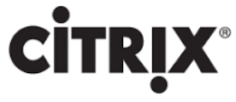
High Level Design
Agent for Windows devices
Supports AAD and AD as Identity source
Connectors for WVD, RDS and Citrix farms

Slide 10
Portal Implementation - server setup
Two Standard installed Windows server VMs in an availability group with an Azure Load Balancer.
Additional Data disk on the servers or Azure Blob storage to store content (such as packages). The content is replicated by the service automatically when local disks are used.
Azure SQL PaaS database.
Prerequisites:
(Public) certificate for SSL support.
DNS registration for the public URL (for example, https://app-portal.contoso.com).
Azure Application registration for SSO

Slide 11
Portal Implementation Guide – Identity source
The application portal comes with its own identity source (‘LOCAL’). This is only used for admin purposes with the standard account ‘admin’.
The default Identity Source for users in SSW is Azure Active Directory. A connector, based on OAuth2, is created and connected to the customers’ tenant. This requires an App Registration in AAD with ClientID and Secret.
By default, users need to be added to the User-role before the can use the application portal. A dynamic or static group is created in AAD which is populated with the proper user accounts. The group is given the User role in the application portal.

Slide 12
Portal Implementation Guide – Identity source
The default Identity Source for admins in SSW is the Windows Active Directory which hosts the servers. A connector is created and connected to the Windows domain. This requires a service account in the domain.
By default, admins need to be added to the Admin-role before the can administer the application portal. A security group is created in AD which is populated with the proper user accounts for admins. The group is given the Admin role in the application portal.

Slide 13
Portal Implementation Guide – Identity source
LOCAL admin account
Used for initial setup and zone administration. Can be used as an escape when other IDP’s are not available.
Administator accounts
Sourced from the Windows Active Directory domain which hosts the servers
Used for administrative tasks by Sogeti Admins
User accounts
Sourced from Azure Active Directory through a dynamic group
Used by end users for the application portal

Slide 14
Portal implementation Guide – Windows Virtual Desktop
A connector is configured to read resources from an Azure Virtual Desktop (AVD) implementation. The connector connects to the feed on the WVD hostpool.
The connector is configured with a service account with permissions of all resources (Published Apps or Desktops) in the AVD setup.
Packages for AVD applications are created using the Connector resources as managed apps.

Slide 15
Portal implementation Guide – Remote Desktop
A connector is configured to read resources from a Microsoft RDS farm. The connector connects to the feed on the Web Access server.
The connector is configured with a service account with permissions of all resources (Published Apps) in the RDS farm.
Packages for RD applications are created using the Connector resources as managed apps.
For this to work, the server must reside in the same network, or a satellite server is used.

Slide 16
Portal implementation Guide – Citrix Farm
A connector is configured to read resources from a Citrix farm. The connector connects to Storefront server.
The connector is configured with a service account with permissions of all resources (Published Apps) in the farm.
Packages for Citrix applications are created using the Connector resources as managed apps.
For this to work, the server must reside in the same network, or a satellite server is used.

Slide 17
Portal Implementation Guide - Automation
Liquit Workspace provides different opportunities for automation:
Liquit Workspace PowerShell module
Separate installation package, to be installed on a management server or workstation
Rest API support
Connector to connect to other zones from which standard packages can be imported

